Slide 1
Next roundtable?
Time series analysis
Extraction of spatio-temporal data (e.g., Copernicus)
Litsearchr
Random forest

Slide 2

Introduction to GitHub
Jennifer Rehren – CollLab 11th November 2021

Slide 3
What is GitHub?

Slide 4






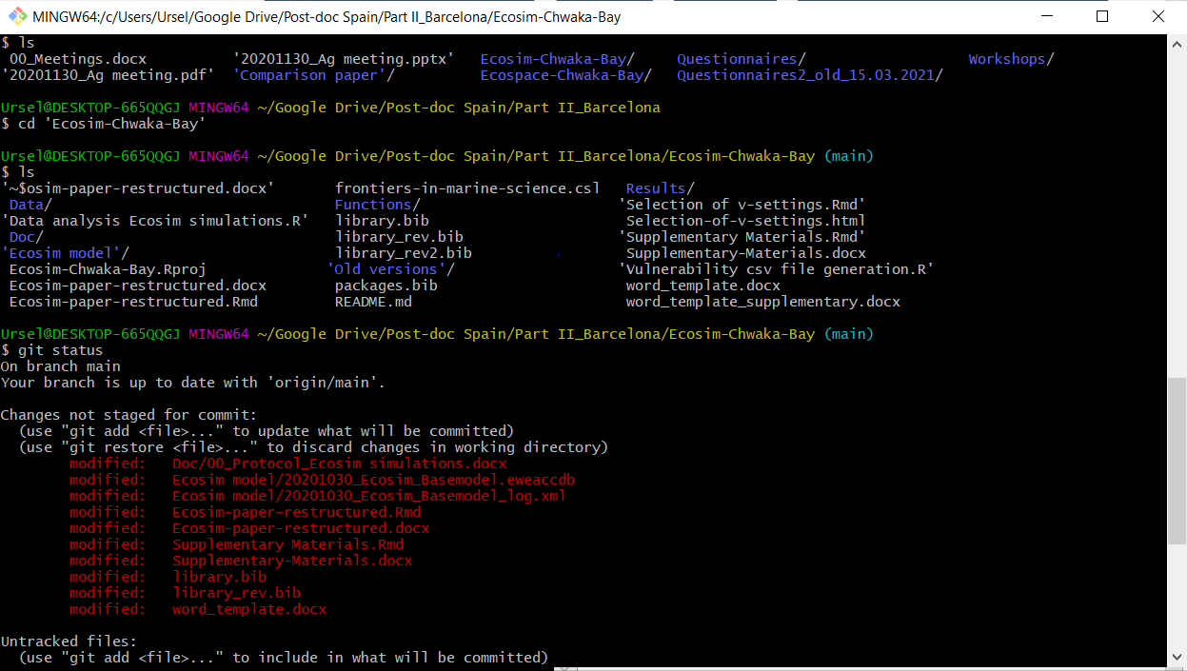
What is Git?
ME
Master Branch
</>
</>
Git: Free version control system to manage your code
Create Branch
Merge
</>
Work Branch
ME

Slide 5


What is GitHub?
ME
Master Branch
</>
</>
Cloud based Git repository hosting service
Store, manage, and share your code
Create Branch
Merge
Pull Request
Work Branch

Slide 6



How I use GitHub…
Keep project partners informed about our project development
Share small projects to help people with their code analysis
Share analysis and data in my publications
Check the code and analysis of my students
Project

Slide 7
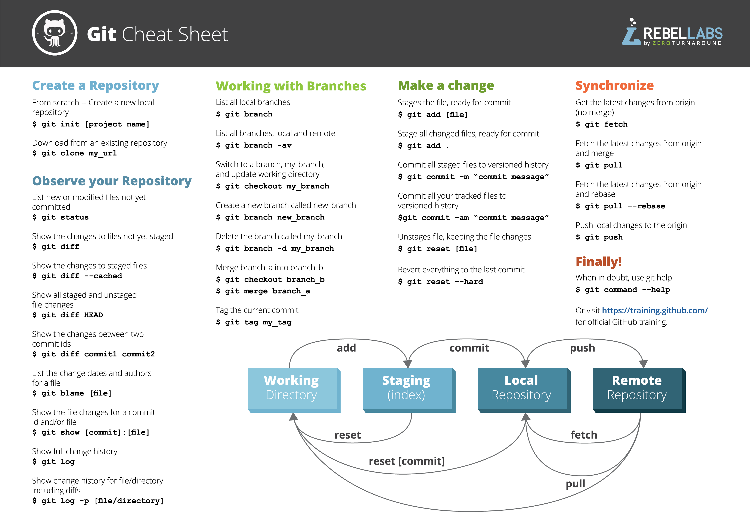
More resources Happy Git with R: https://happygitwithr.com/index.html

Slide 8
Hands on
I create a new public remote repository
I show it once and then you do it yourself:
Clone this new remote repository into my local repository
Make some changes to the R code
Add those changes to the staging arena
Commit these changes! Don‘t forget the message!
Try to push these changes to the remote repository

